Slide 1

Objects and Reference Variables
Instructor: Khurram Iqbal

Slide 2
Java Types
Java Types
Primitive type variables
Reference Type variables

Slide 3


Variable and Reference Variable
Primitive type variables store data directly into their own memory spaces
Reference variables store the address of the object containing the data
String str; //allocates memory space for str
str = “Java Programming”;
int x;
x = 45;
String str = new String(“Java Programming”);
new is an operator, that causes to allocate memory for specific type
and return the address of memory space

Slide 4
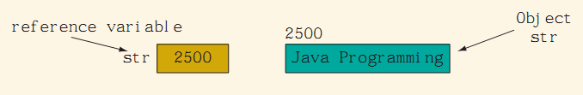
Variable and Reference Variable
“Java Programming” is called a String object and stored at location 2500
str is reference variable of String Type that can store address of any String Object
The operator new create a class object is called instantiating an object of that class
The term variable str means value of str (i.e., address stored in str)
The term object str means whose address is stored in str

Slide 5
Variable and Reference Variable
Reference Types
Import java.awt.Point;
Point1
Point2
100
100
Point point1 = new Point(1,1);
Point point2 = point1;
point2.x = 2;
System.out.println(point1);
Point(1,1)
Addr: 100

Slide 6
Using Predefined Classes and Methods in a Program
Java comes with a wealth of classes called predefined classes
Predefined classes are organized as a collection of packages, called class libraries
Every predefined class contains many predefined methods
Two types of methods in a class
Static
Non-static

Slide 7
Using Predefined Classes and Methods in a Program
Java comes with a wealth of classes called predefined classes
Predefined classes are organized as a collection of packages, called class libraries
Every predefined class contains many predefined methods
Two types of methods in a class
Static
Non-static

Slide 8
Using Predefined Classes and Methods in a Program
Static Methods
ClassName.method() e.g., Math.pow(x,y)
Instance Methods
Object.method()
dot (. ) is an operator called the member access operator

Slide 9
Object-oriented programming (OOP) involves programming using objects.
A class defines the properties and behaviors for objects.
An object represents:
An entity in the real world that can be distinctly identified.
For example, a student, a desk, a circle, a button, loan etc.
An object has a unique identity
State:
The state of an object also known as its properties or attributes is represented by data fields with their current values.
A circle object, for example, has a data field radius, which is the property that characterizes a circle.
A rectangle object, for example, has the data fields width and height, which are the properties that characterize a rectangle.
The behavior of an object (also known as its actions) is defined by methods.
To invoke A method on an object to perform an action.
For example, you may define methods named:
getArea() and getPerimeter() for circle objects.
A circle object may invoke getArea() to return its area and getPerimeter() to return its perimeter.
You may also define the setRadius(radius) method. A circle object can invoke this method to change its radius.

Slide 10
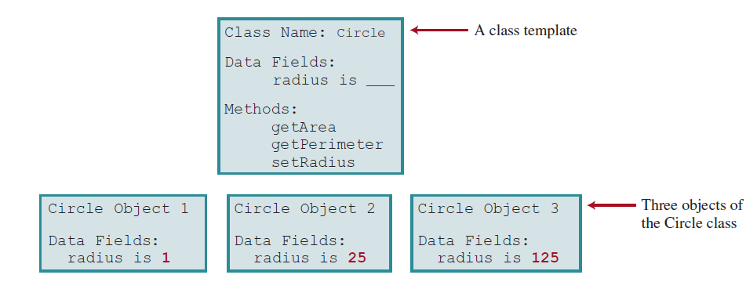
Defining Classes for Objects
A class is a template, blueprint, or contract that defines what an object’s data fields and methods will be. Objects of the same type are defined using a common class.
An object is an instance of a class. You can create many instances of a class.
Creating an instance is referred to as instantiation. The terms object and instance are often interchangeable.
You can make as many apple pies as you want from a single recipe.
A Java class uses variables to define data fields and methods to define actions.
In addition, a class provides methods of a special type, known as constructors, which are invoked to create a new object.
A constructor can perform any action, but constructors are designed to perform
initializing actions, such as initializing the data fields of objects.

Slide 11
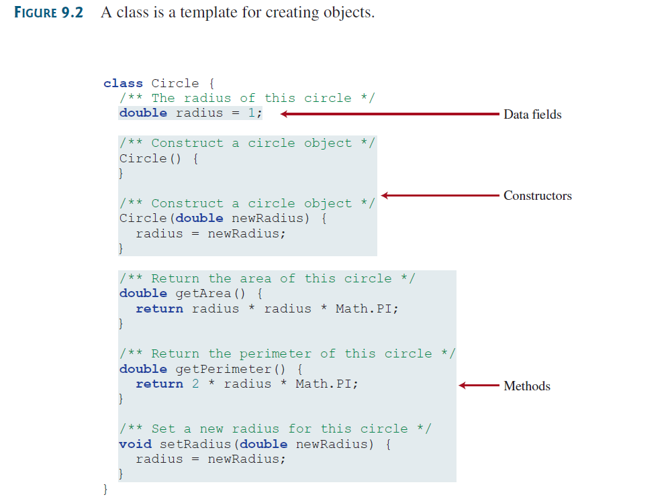

Slide 12
